Slide 1
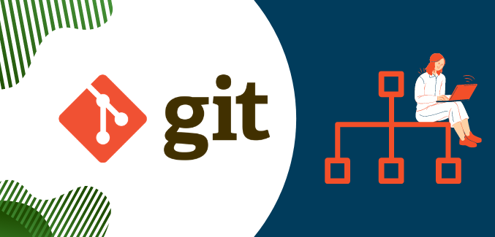
Introduction to Git
Shlomi Alon
July 2022

Slide 2
Agenda
Version Control Systems Basics
Git History
What is Git?
Why Git?
States of a Git File
Sections of a Git Project

Slide 3
Version Control Systems Basics
A version control system is a software tool that allows to record changes brought in time to a file or a set of files in order to be able to recall specific versions later.
Using this system one can:
revert files / sets of files to a previous state
review the changes made over time
working together and minimizing edit conflicts
get little overhead by storing differences instead of full copies of files
backup files automatically
The core of the Version Control System is the repository. It refers to the data structure stored on the server which contains a set of files (grouped or not in directories), a history log of changes made in the files, a set of version control system files for data handling and management.

Slide 4
Git History
By far, the most widely used modern version control system in the world today is Git.
Git is a mature, actively maintained open-source project originally developed in 2005 by
Linus Torvalds, the famous creator of the Linux operating system kernel.

Slide 5
What is Git?
Git is a fully distributed Version Control System, widely used because of its speed, efficiency in handling large projects and the powerful branching mechanism which ensures a good management of many parallel branches.
Git is different from the other Version Control Systems in terms of:
Data handling (save snapshots, not differences)
Locality (no network latency in getting the entire change history)
Data integrity (check-summing based on the content of the file / files)
Handling errors (hard to loose changes, recovery is easy)
Clear workflow based on states

Slide 6
Why Git?
Save Time
Work Offline
Undo Mistakes
Don’t Worry
Go With the Flow
Open Source
Many Clients
Make Useful Commits
Don’t Mix Things Up
Notes:
Save Time
Git is lightning fast. And although we're talking about only a few seconds per command, it quickly adds up in your work day. Use your time for something more useful than waiting for your version control system to get back to you.
Work Offline
What if you want to work while you're on the move? With a centralized VCS like Subversion or CVS, you're stranded if you're not connected to the central repository. With Git, almost everything is possible simply on your local machine: make a commit, browse your project's complete history, merge or create branches... Git let's you decide where and when you want to work.
Undo Mistakes
People make mistakes. A good thing about Git is that there's a little "undo" command for almost every situation. Correct your last commit because you forgot to include that small change. Revert a whole commit because that feature isn't necessary, anymore. And when the going gets tough you can even restore disappeared commits with the Reflog - because, behind the scenes, Git rarely really deletes something. This is peace of mind.
Don't Worry
Git gives you the confidence that you can't screw things up - and this is a great feeling. In Git, every clone of a project that one of your teammates might have on his local computer is a fully usable backup. Additionally, almost every action in Git only adds data (deleting is very rare). That means that losing data or breaking a repository beyond repair is really hard to do.
Make Useful Commits
A commit is only really useful if it just contains related changes. Imagine having a commit that contains something from feature A, a little bit of feature B, and bugfix C. This is hard to understand for your teammates and can't be rolled back easily if some of the code is causing problems. Git helps you create granular commits with its unique "staging area" concept: you can determine exactly which changes shall be included in your next commits, even down to single lines. This is where version control starts to be useful.
Work in Your Own Way
When working with Git you can use your very own workflow. One that feels good for you. You don’t have to be a code acrobat to qualify for using Git. Of course, you can connect with multiple remote repositories, rebase instead of merge, and work with submodules when you need it. But you can just as easily work with one central remote repository like in Subversion. All the other advantages remain – regardless of your workflow.
Don’t Mix Things Up
Separation of concerns is paramount to keeping track of things. While you’re working on feature A, nothing (and no-one) else should be affected by your unfinished code. What if it turns out the feature isn’t necessary anymore? Or if, after 10 commits, you notice that you took a completely wrong approach? Branching is the answer for these problems. And while other version control systems also know branches, Git is the first one to make it work as it should: fast & easy.
Go With the Flow
Only dead fish swim with the stream. And sometimes, clever developers do, too. Git is used by more and more well-known companies and Open Source projects: Ruby On Rails, jQuery, Perl, Debian, the Linux Kernel and many more. A large community often is an advantage by itself because an ecosystem evolves around the system. Lots of tutorials, tools, and services make Git even more attractive.

Slide 7
Git: the three states
Git has three main states that your files can reside in:
Committed
Modified
Staged
These three states make a system based on the promotion. Each file can reside in one of these three states and change states depending on what was done to it.

Slide 8
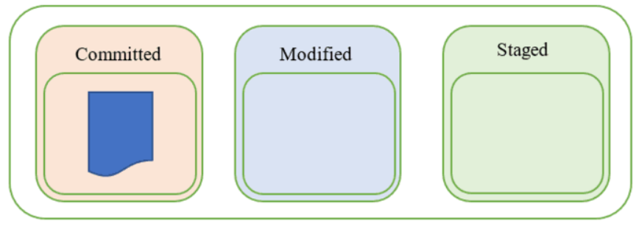
Git: the three states – Committed
This state indicates that the file is safely stored in the local database.

Slide 9
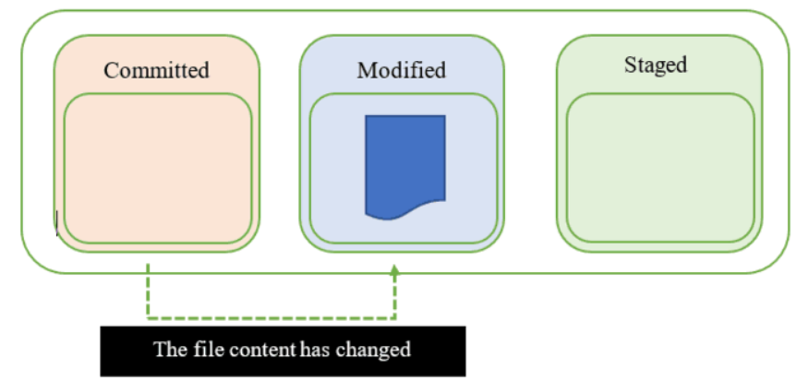
Git: the three states – Modified
When any change to the file occurs, the state of the file changes from committed to modified. This means that the document has changed since its last committed version which is saved to our local database. We can see this state as 'we're currently working on this file, there will still be more changes'.

Slide 10
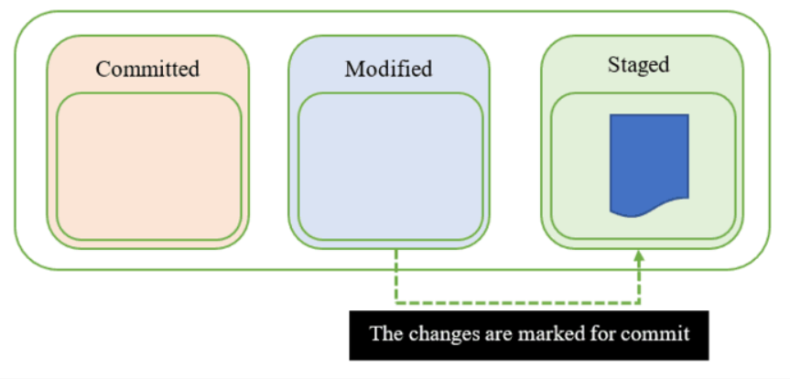
Git: the three states – Staged
When we're finished with all the modifications to our file, it moves to the staged state. The file is now ready to be added to the local git database, you have marked it to go into your next commit snapshot.

Slide 11
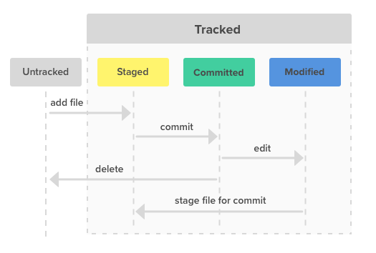
Git: the three states

Slide 12
Git: the three Sections
Similar to how files can be in three different states, a Git project consists of three different sections:
The first section is the .git directory, also known as the repository. This is where Git stores the metadata and object database for your project.
The next section is the working directory. This is a single checkout of one version of the project. This is where you can modify files.
The third section is the staging area, also known as the index. It's the area between the working directory and the .git directory. All the files which are ready for a commit are stored here.
When we commit, what is in the staging area moves to the new version of the repository. This excludes what is in the working directory. This allows us to change files however we like, but only what we move to the staging area will be committed. Everything we changed but do not want to put in a repository stays in the working directory.
Notes:
Similar to how files can be in three different states, a Git project consists of three different sections.
The first section is the .git directory, also known as the repository. This is where Git stores the metadata and object database for your project.
The next section is the working directory. This is a single checkout of one version of the project. This is where you can modify files.
The third section is the staging area, also known as the index. It's the area between the working directory and the .git directory. All the files which are ready for a commit are stored here.
When we commit, what is in the staging area moves to the new version of the repository. This excludes what is in the working directory. This allows us to change files however we like, but only what we move to the staging area will be committed. Everything we changed but do not want to put in a repository stays in the working directory.

Slide 13
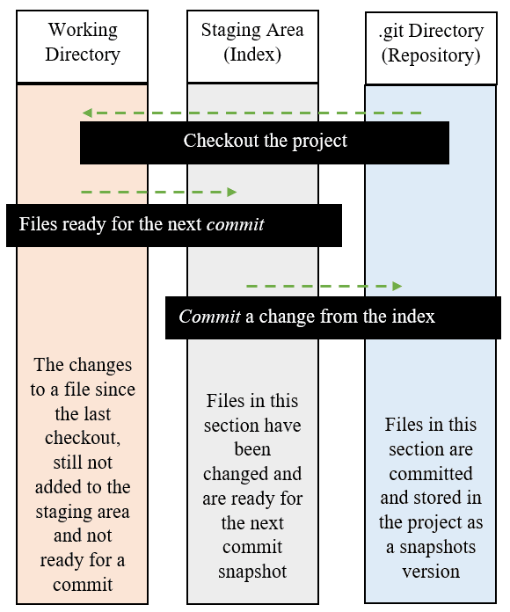
Git: the three Sections

Slide 14
Thank You.

